Slide 1
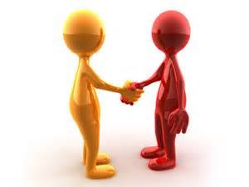
Greetings & Responses

Slide 2
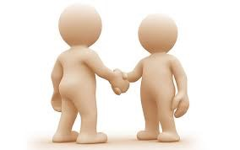
I’m Fine..
How are you?

Slide 3
Most of the time
we usually answer with
“Fine!”

Slide 4

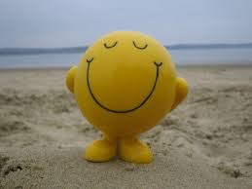
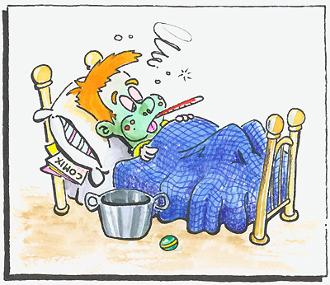
Don’t you actually tell people how you feel?
Not always..

Slide 5
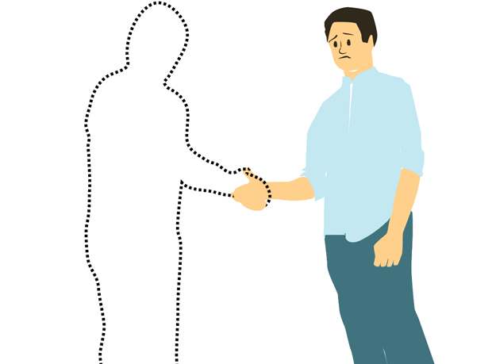
Mostly we use same answer in all the situations
Official Meeting
Informal Meeting
Meeting Friends
Negative Situation
Sick & Bedridden
Meeting old friend

Slide 6
I’m Fine..
How are you?

Slide 7
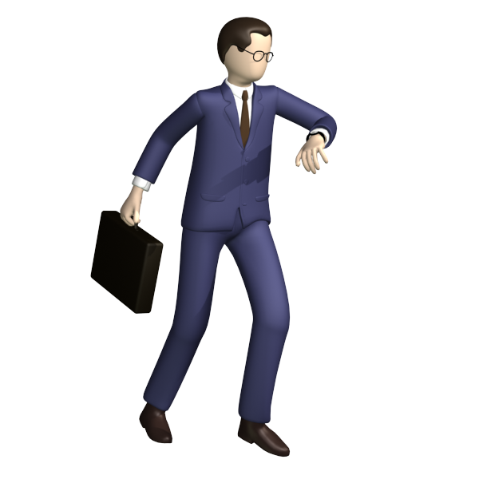
I’m Fine..
If you don’t say anything else,
it is a signal that you don't want to continue the conversation.

Slide 8
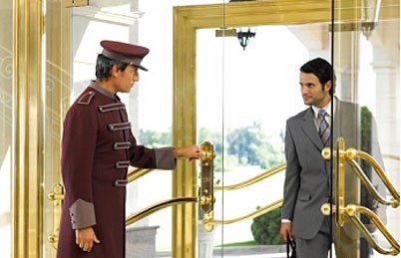
How are you?
I’m Fine, Thanks
This answer is formal.
You might answer this way if someone you don't know,
e.g.. waiter at a restaurant

Slide 9
Greetings for acquaintances and strangers

Slide 10
I’m fine, thanks. And you?
How are you?
Better.. shows interest to continue conversation

Slide 11
Not bad. How about you?
How are you?
This is a more friendly-sounding answer than "fine".

Slide 12
Pretty Good. How about you?
How are you?
Much, much more casual.

Slide 13
Negative Situation Response

Slide 14
Oh! I’m hanging in there..
How are you?
This answer makes it sound like you're having a tough day.

Slide 15
I've been better.
How are you?
This means that you want to tell the listener your sad story.

Slide 16
How are you?
I've been better.
Oh! What’s wrong?
If somebody replies you “I've been better” or
“I’m hanging in there..”
Never forget to ask.. “What's wrong?”

Slide 17
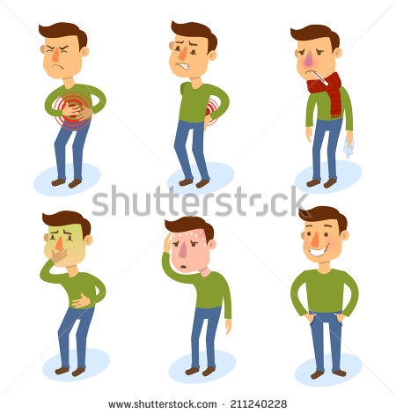
Greeting someone who is/was not well
How are you feeling?
How are you keeping now?
I am suffering from ...
I've been feeling better
I am okay now,
Thank you.

Slide 18
Greetings for friends or family

Slide 19

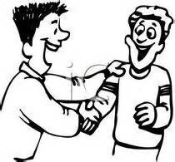
Hey! What’s up?
Fine, thanks. And you?

Slide 20
What's up?
Nothing much,
What’s up with you?

Slide 21
What's up?
No much.
I've been crazy busy!

Slide 22
Hey! How’s it going?
It’s going well.
How about you?

Slide 23
What's new?
Oh! Just the usual.

Slide 24
Hey! What’s up?
What’s going on?
Nothing new
Nothing Much
What’s new?
How’s it going?
It’s going
Great!.
Nothing too exciting
Informal Variations of “How Are You?”
How’ve you been?
How’s life?
I have been dealing with same old stuff.
The same as usual.

Slide 25
To start a friendly talk,
Try to give more info

Slide 26
Not great,
I just broke up with
my girlfriend.
How are you?

Slide 27
It’s awesome. ,
I just got a new car.
How are you?

Slide 28
I’ve been better.
I think I’m getting sick.
How are you?

Slide 29
Meeting someone after a break

Slide 30
Hey! How have you been?
It means basically the same thing as how are you,
but looks backward towards the time when you last saw a person
I have been better
I have been dealing with same old stuff.
I have been working an IT company.
I have been okay.
I have been quite busy.

Slide 31
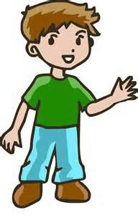
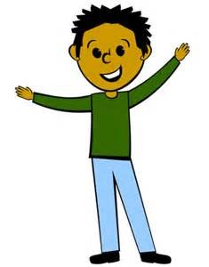
Greeting a person you haven’t seen for a long time
It’s been along time.
It’s been too long.
How long has it been?
It’s been such a long time.
Where have you been hiding?
It’s been ages since we last met.
Long time no see.
It's great to see you again.
I'm so happy we reconnected.
When was the last time we saw each other?
Yes, it's been a long time, how are you man?"
It seems like more than a year, I am doing
pretty well, How are you?
what a surprise to see you!

Slide 32
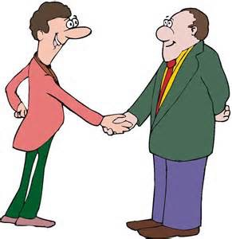
Delighted to meet you
Pleased to meet you
Glad to meet you
It’s always a pleasure to see you.
Delighted to meet you too
Pleased to meet you too
Glad to meet you too
Is this your first time here?

Slide 33
I’m fine, thanks. And you?
Oh! What’s wrong?
How are you?
I've been better.
How’ve you been?
Official Meeting
Informal Meeting
Meeting Friends
Being Sick & Bedridden
Meeting old friend
Hey! What’s up?
I have been dealing with same old stuff.
Nothing Much
Pleased to meet you
Pleased to meet you too
How are you feeling?
I've been feeling better

Slide 34
Thank You

